Slide 1

MACHINE LEARNING REGRESSION
ARTIFICIAL NEURAL NETWORKS

Slide 2
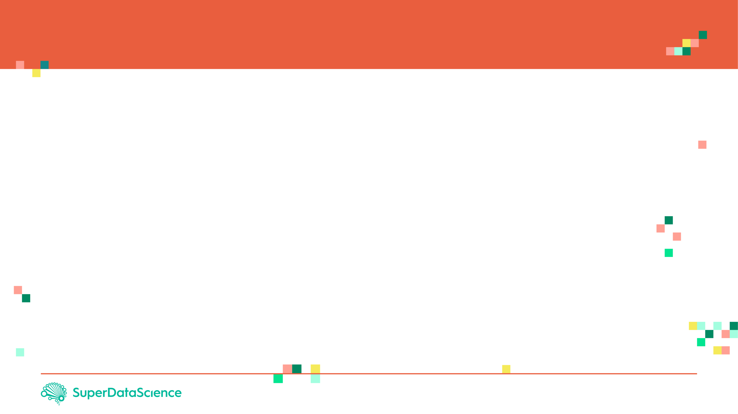
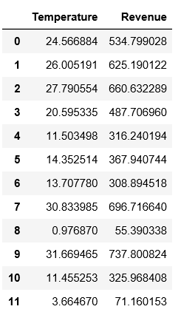

REVIEW: WHAT IS REGRESSION?
Regression works by predicting value of one variable Y based on another variable X.
X is called the independent variable and Y is called the dependant variable.
REVENUE($)
TEMPERATURE (DegC)
2
Source: https://www.goodfreephotos.com/vector-images/ice-cream-stand-vector-clipart.png.php

Slide 3

REGRESSION MATH!
Goal is to obtain a relationship (model) between outside air temperature and ice cream sales revenue
MODEL! (GOAL)
REVENUE($)
$$y=b+m∗x$$
$20
DEPENDANT VARIABLE
REVENUE ($)
INDEPENDENT VARIABLE
TEMPERATURE (DegC)
+10 degC
TEMPERATURE (DegC)

Slide 4
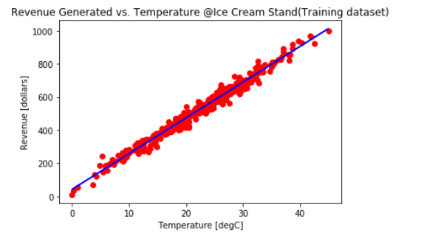





HOW ARE WE GOING TO USE THE MODEL?
Once the coefficients m and b are obtained, you have obtained a simple linear regression model!
This “trained” model can be later used to predict any Revenue (dollars) based on the outside air Temperature.
$$\text{y}\text{ = }\text{mX}\text{+}\text{b}$$
$$Y$$
DEPENDANT
VARIABLE
INDEPENDANT
VARIABLE
$$m$$
$$b$$
$$X$$

Slide 5
PROJECT OVERVIEW

Slide 6
PROJECT OVERVIEW
Dataset includes house sale prices for King County in Washington, USA.
Homes that are sold in the time period: May, 2014 and May, 2015.
Data Source: https://www.kaggle.com/harlfoxem/housesalesprediction
Model inputs:
ida: notation for a house
date: Date house was sold
bedrooms: Number of Bedrooms
bathrooms: Number of bathrooms
sqft_living: home square footage
sqft_lot: square footage of the lot
floors: Total floors (levels) in house
waterfront: waterfront property
INPUTS
REGRESSION MODEL
HOUSE PRICE

Slide 7
PROJECT OVERVIEW
Model inputs:
condition: How good the condition is ( Overall )
grade: overall grade given to the housing unit, based on King County grading system
sqft_abovesquare: footage of house apart from basement
sqft_basement: square footage of the basement
yr_built: Built Year
yr_renovated: Year when house was renovated
zipcode: zip
lat: Latitude coordinate
long: Longitude coordinate
sqft_living15: Living room area in 2015
sqft_lot15: lotSize area in 2015(implies-- some renovations)
The model should predict:
House Price

Slide 8
WHAT ARE ANNs AND HOW DO THEY LEARN?

Slide 9
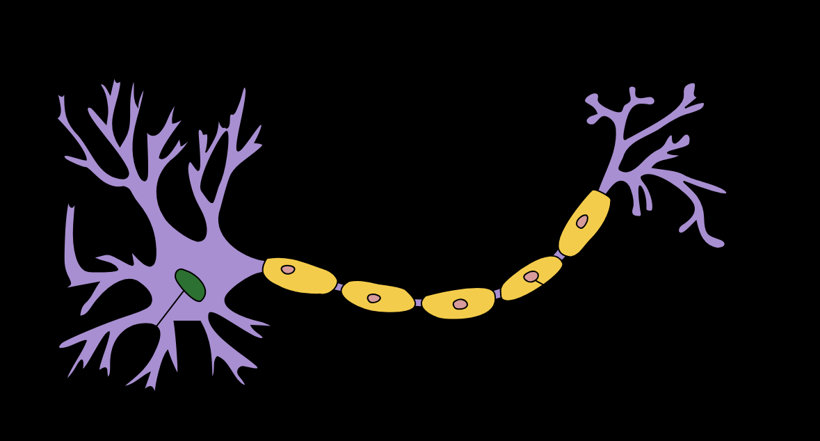
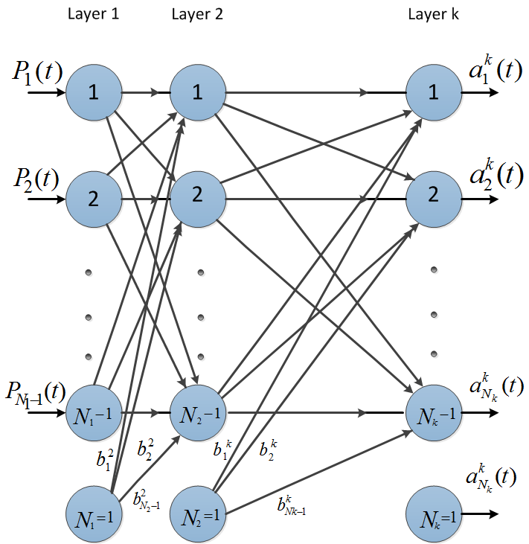
ARTIFICIAL NEURAL NETWORK: INTRODUCTION
The brain has over 100 billion neurons communicating through electrical and chemical signals.
Neurons communicate with each other and help us see, think, and generate ideas.
Human brain learns by creating connections among these neurons.
ANNs are information processing models inspired by the human brain.
Photo Credit: https://commons.wikimedia.org/wiki/File:Neuron_Hand-tuned.svg

Slide 10
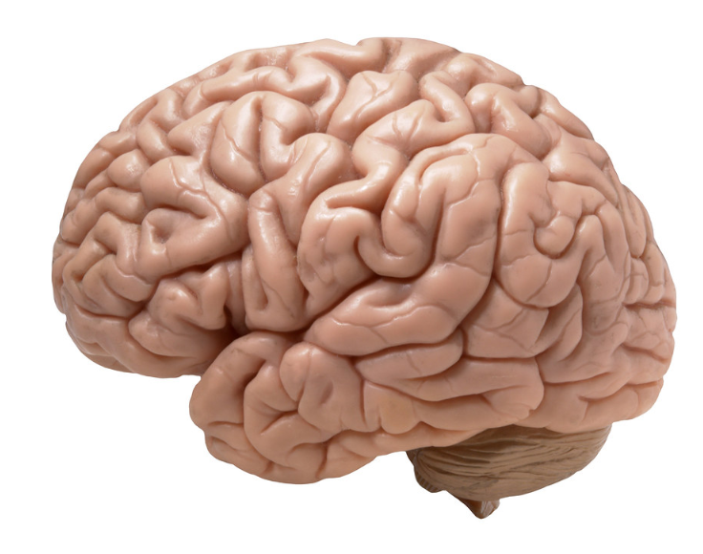

HOW DO HUMANS LEARN? FROM EXPERIENCE
Humans learn from experience (by example)
~Desired Outputs
LABEL: CAT!
Inputs
Deviated Outputs
Desired (Correct) Output
Update
Error
Photo Credit: https://www.flickr.com/photos/flamephoenix1991/8376271918
Photo Credit: https://www.pexels.com/photo/grey-and-white-short-fur-cat-104827/

Slide 11
SINGLE NEURON MODEL

Slide 12
NEURON MATHEMATICAL MODEL
The neuron collects signals from input channels named dendrites, processes information in its nucleus, and then generates an output in a long thin branch called axon.
X1
W1
NEURON
X2
W2
W3
DENDRITES
X3
AXON
NUCLEAS

Slide 13








NEURON MATHEMATICAL MODEL
Bias allows to shift the activation function curve up or down.
Number of adjustable parameters = 4 (3 weights and 1 bias).
Activation function “F”.
b
$$X_{1}$$
$$W_{1}$$
F
$$W_{2}$$
INPUTS/INDEPENDENT VARIABLES
$$X_{2}$$
$$W_{3}$$
$$X_{3}$$
$$y=f(X_{1}W_{1}+X_{2}W_{2}+X_{3}W_{3}+b)$$

Slide 14
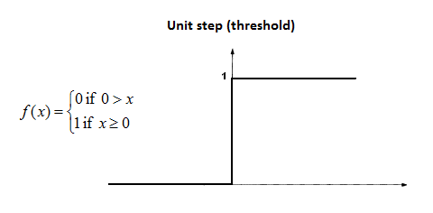










SINGLE NEURON MODEL IN ACTION
Let’s assume that the activation function is a Unit Step Activation Function.
The activation functions is used to map the input between (0, 1).
$$b=0$$
Input #1=1
$$X_{1}$$
$W_{1}$=0.7
F
$$X_{2}$$
$$W_{2}=0.1$$
Input #2=3
$$W_{3}=0.3$$
$$y=f\left(X_{1}W_{1}+X_{2}W_{2}+X_{3}W_{3}+b\right)$$
Input #3=4
$$X_{3}$$
$$y=f\left(1∗0.7+3∗0.1+4∗0.3\right)=f(2.2)$$
$$y=1 (because 2.2>0)$$

Slide 15
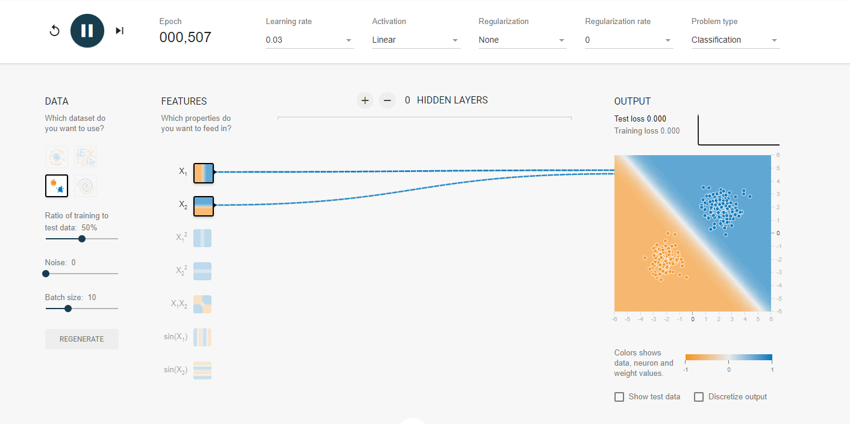
SINGLE NEURON MODEL IN ACTION
Check this out: https://playground.tensorflow.org

Slide 16
NETWORK TRAINING

Slide 17
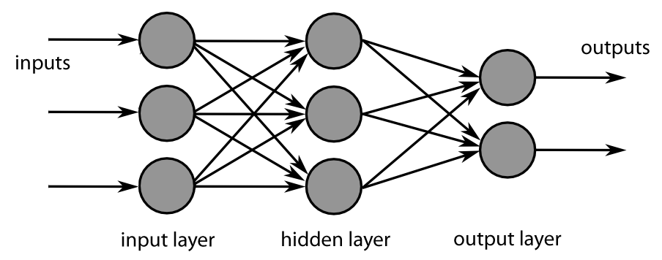
NETWORK TRAINING: BACK PROPAGATION
Backpropagation is a method used to train ANNs by calculating gradient needed to update network weights.
It is commonly used by the gradient descent optimization algorithm to adjust the weight of neurons by calculating the gradient of the loss function.
STEP 1: FORWARD PROPAGATION
STEP 2: ERROR CALCULATION
STEP 4: WEIGHT UPDATE
STEP 3: BACK PROPAGATION

Slide 18
NETWORK TRAINING: BACK PROPAGATION
Backpropagation Phase 1: propagation
Propagation forward through the network to generate the output value(s)
Calculation of the cost (error term)
Propagation of output activations back through network using training pattern target in order to generate the deltas (difference between targeted and actual output values)
STEP 1: FORWARD PROPAGATION
STEP 2: ERROR CALCULATION
STEP 4: WEIGHT UPDATE
STEP 3: BACK PROPAGATION

Slide 19
NETWORK TRAINING: BACK PROPAGATION
Phase 2: weight update
Calculate weight gradient.
A ratio (percentage) of the weight's gradient is subtracted from the weight.
This ratio influences the speed and quality of learning and called learning rate. The greater the ratio, the faster neuron train, but lower ratio, more accurate the training is.
STEP 1: FORWARD PROPAGATION
STEP 2: ERROR CALCULATION
STEP 4: WEIGHT UPDATE
STEP 3: BACK PROPAGATION

Slide 20
READING MATERIALS: BACK PROPAGATION
“Backpropagation neural networks: A tutorial” by Barry J.Wythoff
“Improved backpropagation learning in neural networks with windowed momentum”, International Journal of Neural Systems, vol. 12, no.3&4, pp. 303-318.

Slide 21
MULTI-NEURON MODEL

Slide 22
TWO NEURON MODEL: MATRIX REPRESENTATION
The network is represented by a matrix of weights, inputs and outputs.
Total Number of adjustable parameters = 8:
Weights = 6
Biases = 2
P1
W1
W2
n1
a1
Matrix Representation
P2
∑
f
W3
P3
b1
P1
W1
W2
n2
a2
P2
∑
f
W3
P3
b1

Slide 23
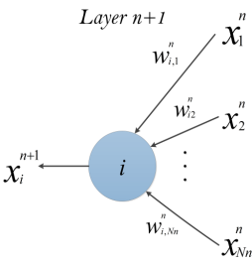



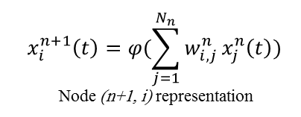
MULTI-LAYER PERCEPTRON MODEL: MATRIX REPRESENTATION
$$x_{i}^{n+1}\left(t\right)=φ(\sum_{j=1}^{N_{n}}{w_{i, j}^{n}}x_{j}^{n}\left(t\right))$$
Node (n+1, i) representation
$$\left[\begin{matrix}\begin{matrix}W_{11} & W_{12} \\ W_{21} & W_{22}\end{matrix} & ⋯ & \begin{matrix}W_{1{, N}_{1}} \\ W_{2{, N}_{1}}\end{matrix} \\ ⋮ & ⋱ & ⋮ \\ \begin{matrix}W_{m−1,1} & W_{m−1,2} \\ W_{m,1} & W_{m,2}\end{matrix} & ⋯ & \begin{matrix}W_{m−1{, N}_{1}} \\ W_{m{, N}_{1}}\end{matrix}\end{matrix}\right]$$
Non-Linear Sigmoid Activation function
$$φ\left(w\right)=\frac{1}{1+e^{−w}}$$
m: number of neurons in the hidden layer
$N_{1}$: number of inputs

